Slide 1
Review
Stat 350 Regression Analysis

Slide 2
Population versus sample
Population: The entire group of individuals in which we are interested but can’t usually assess directly
  Example: All humans, all working-age people in Illinois, all crickets
A parameter is a number describing a characteristic of the population.
Sample: The part of the population we actually examine and for which we do have data
  How well the sample represents the population depends on the sample design.
A statistic is a number describing a characteristic of a sample.
Population
Sample

Slide 3
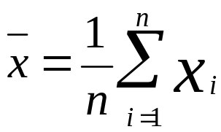
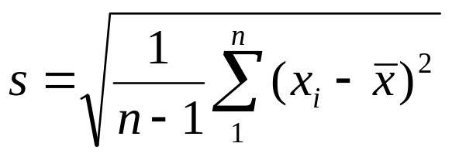
Mean and standard deviation
Sample:
  Sample mean
  Sample standard deviation: variation around the mean
Population:
  Population mean μ
  Population standard deviation σ
Population
Sample

Slide 4
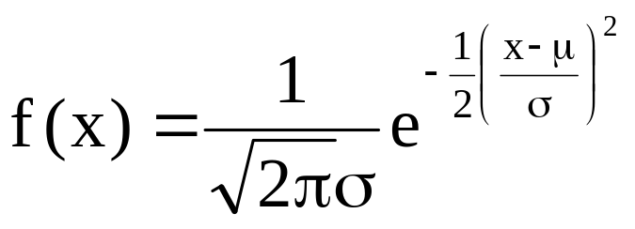
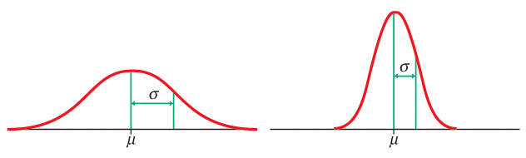
Normal distributions
Normal—or Gaussian—distributions are a family of symmetrical, bell- shaped density curves defined by a mean μ (mu) and a standard deviation σ (sigma): N (μ, σ).
x
x
e = 2.71828… The base of the natural logarithm
π = pi = 3.14159…
Notes:
Commonly called the bell curve - if were skiing down it you are going steeper and steeper, then starts to flatten out.
This is the equation - don’t have to know it - basically for every value x, gestation time, you can plug it in and get f(x), the value on the y axis.
What we have done here is to go from a histogram, which is just your few data points, to this curve, which is a representation of what values you would get for any possible value of x whether you have it in your data set or not.

Slide 5
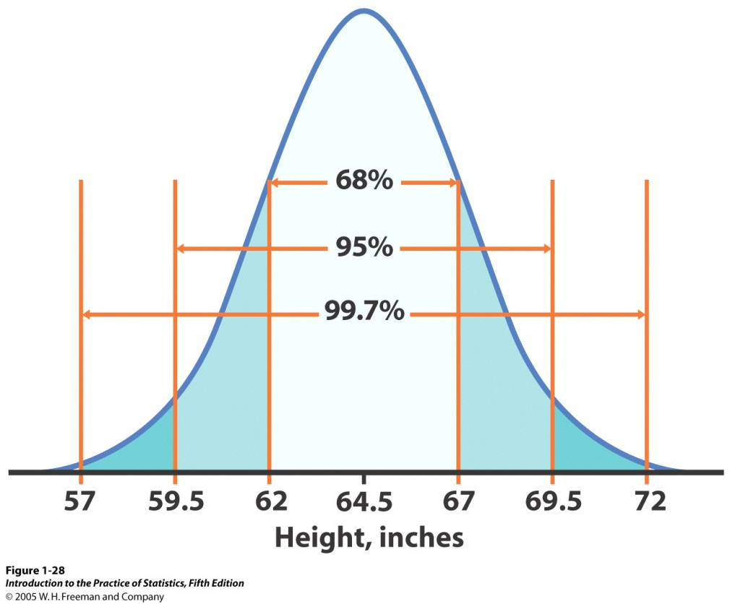
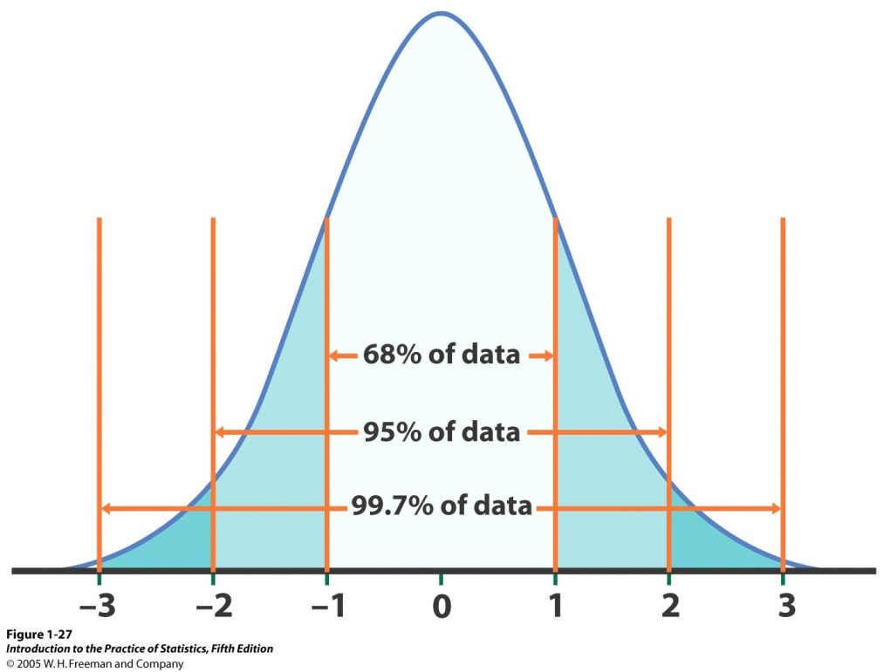


The standard Normal distribution
Because all Normal distributions share the same properties, we can standardize our data to transform any Normal curve N (μ, σ) into the standard Normal curve N (0,1).
N(64.5, 2.5)
N(0,1)
=>
Standardized height (no units)
For each x we calculate a new value, z (called a z-score).

Slide 6
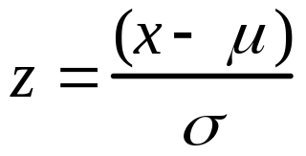
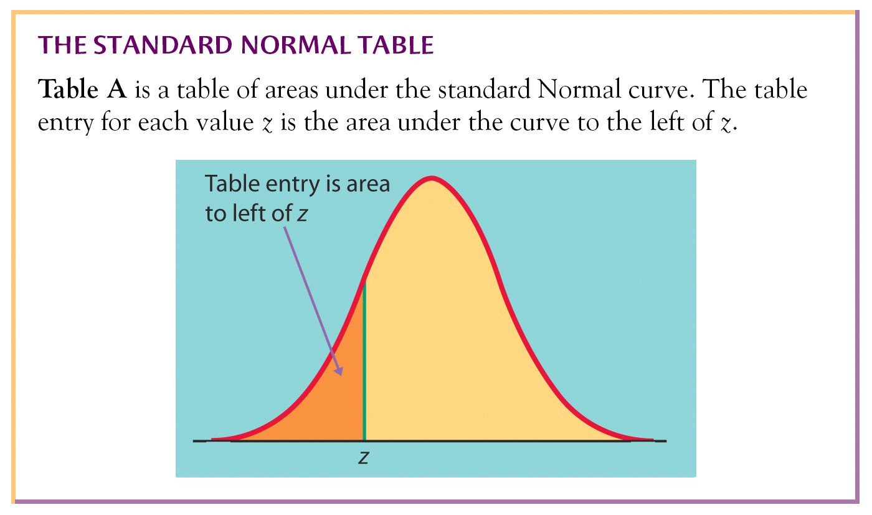
Standardizing: calculating z-scores
A z-score measures the number of standard deviations that a data value x is from the mean μ.

Slide 7
What is a sampling distribution?
The sampling distribution of a statistic is the distribution of all possible values taken by the statistic when all possible samples of a fixed size n are taken from the population. It is a theoretical idea—we do not actually build it.
The sampling distribution of a statistic is the probability distribution of that statistic.
What is the sampling distribution of sample mean?

Slide 8

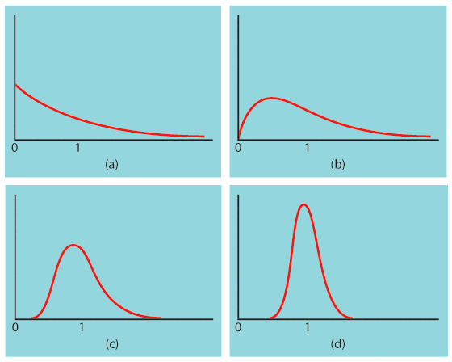

The central limit theorem
Central Limit Theorem: When randomly sampling from any population with mean μ and standard deviation σ, when n is large enough, the sampling distribution of is approximately normal: N(μ,σ/√n).
Population with strongly skewed distribution
Sampling distribution of for n = 2 observations
Sampling distribution of for n = 10 observations
Sampling distribution of
for n = 25
observations

Slide 9
Statistical inferences
Confidence interval
Hypothesis testing
population sample

Slide 10
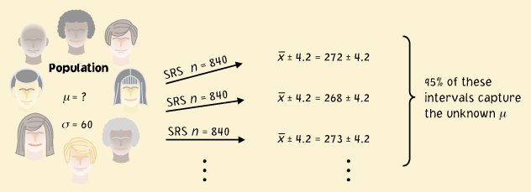
Confidence interval
A level C confidence interval for a parameter has two parts:
An interval calculated from the data, usually of the form
  estimate ±margin of error = estimate ± critical value × SE(estimate)
A confidence level C, which gives the probability that the interval will capture the true parameter value in repeated samples, or the success rate for the method.

Slide 11
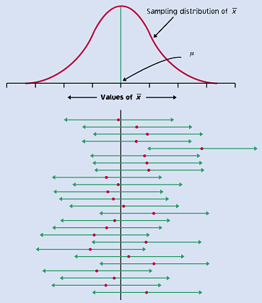
Red dot: mean value
of individual sample
This reasoning is the essence of statistical inference.

Slide 12
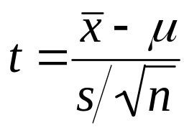
The t distributions – one sample t
One sample of size n from a normal population N(µ,σ):
When σ is known, the sampling distribution of is normal N(μ, σ/√n).
When σ is estimated from the sample standard deviation s, then the sampling distribution follows a t distribution t(μ,s/√n) with degrees of freedom n − 1.
Standardization
t(0,1)
df = n − 1

Slide 13
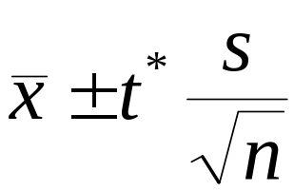
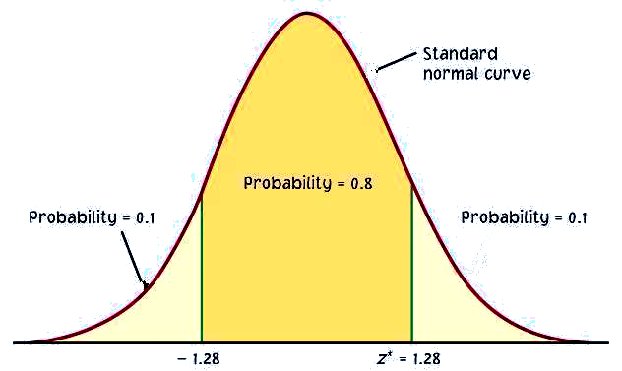
Confidence intervals
We have a set of data from a population with both μ and σ unknown. We use to estimate μ, and s to estimate σ, using a t distribution (df n − 1).
The 100×C % confidence interval for μ is:
Practical use of t: t*
C is the area under the t (df: n−1) curve between −t* and t*.
We find t* using t Table for df = n−1 and confidence level C.
C
−t*
t*

Slide 14
Hypotheses tests
A test of statistical significance tests a specific hypothesis (an assumption, or a theory about the characteristics of one or more variables in one or more populations) using sample data to decide on the validity of the hypothesis.
Follow these steps:
  State the null and alternative hypotheses
  Compute the test statistic
  Get the p-value (the chance of obtaining a particular random sample result if the null hypothesis were true)
  Draw conclusion
    If the P-value is equal to or less than α (p ≤ α), then we reject H₀.
    If the P-value is greater than α (p > α), then we fail to reject H₀.
    The significance level, α, is the largest P-value tolerated for rejecting a true null hypothesis

Slide 15
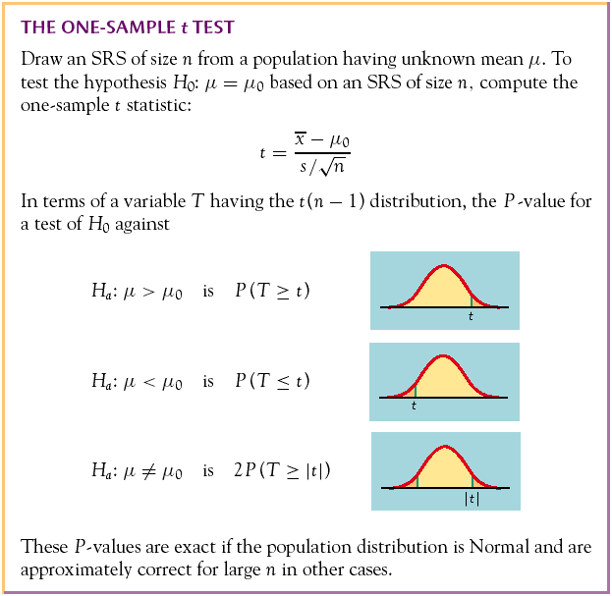
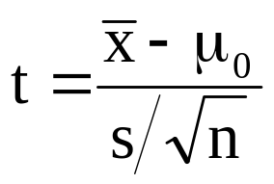
P-value in one-sided and two-sided tests
One-sided
(one-tailed)
Two-sided
(two-tailed)

Slide 16
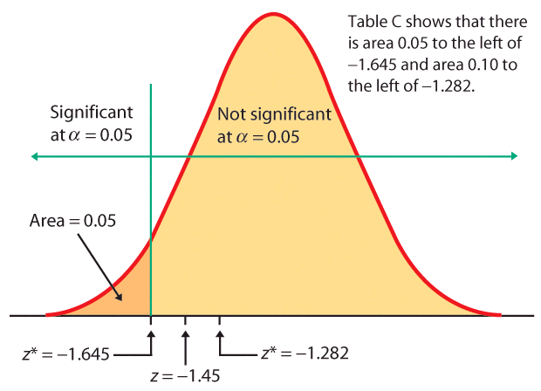
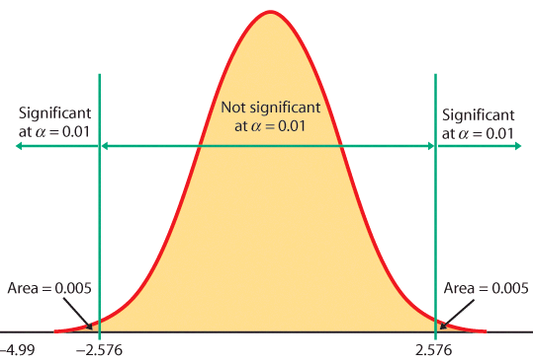
Rejection region
When the test statistic falls within the rejection region (shaded area on the tail-side), the P-value is smaller than α and you have shown statistical significance.
One-sided test, α = 5%
Two-sided test, α = 1%

Slide 17
Example: one-sample t
Cola manufacturers want to test how much the sweetness of a new cola drink is affected by storage. The sweetness loss due to storage was evaluated by 10 professional tasters (by comparing the sweetness before and after storage):
  Taster Sweetness loss
  1 2.0
  2 0.4
  3 0.7
  4 2.0
  5 −0.4
  6 2.2
  7 −1.3
  8 1.2
  9 1.1
  10 2.3
Obviously, we want to test if storage results in a loss of sweetness. Let μ denote the sweetness loss, thus: H0: μ = 0 versus Ha: μ > 0

Slide 18
Example: Computation
Follow the four steps:

Slide 19

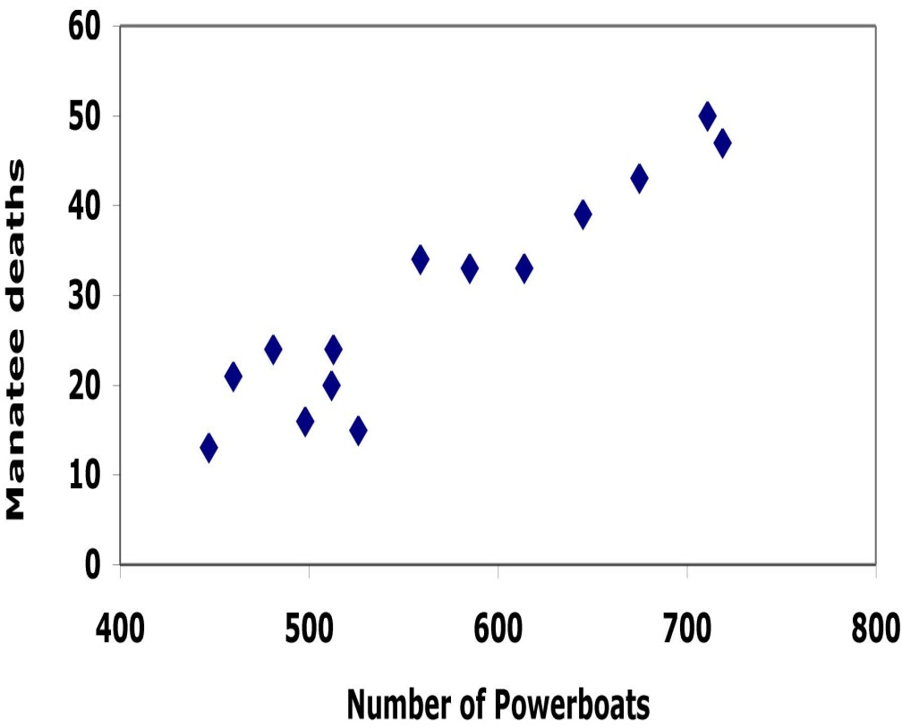
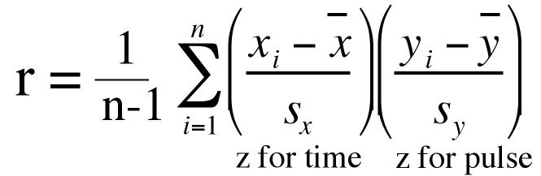
Relationships of two variables
A response variable measures or records an outcome of a study. An explanatory variable explains changes in the response variable.
The explanatory or independent variable: x
The response or dependent variable: y
Correlation coefficient
(in 1000s)

Slide 20
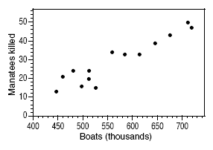
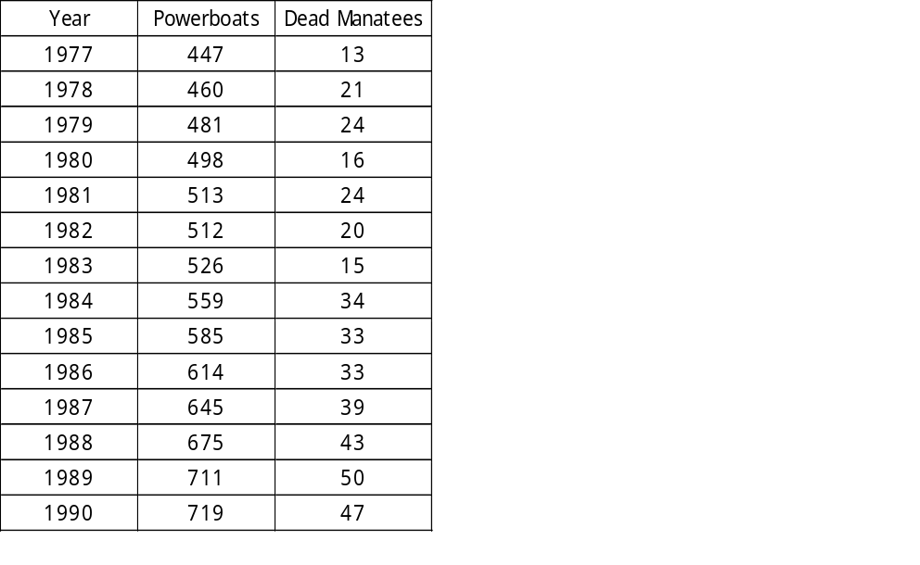

(in 1000’s)
There is a positive linear relationship between the number of powerboats registered and the number of manatee deaths.
The least-squares regression line has for equation:
Thus, if we were to limit the number of powerboat registrations to 500,000, what could we expect for the number of manatee deaths?
Roughly 21 manatees.

